Slide 1
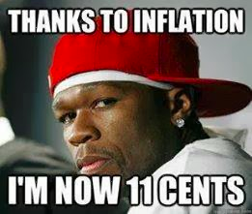
Chapter 8: Inflation
Wayne Geerling
University of Texas

Slide 2
Big Questions
1. How is inflation measured?
2. What problems does inflation bring?
3. What is the cause of inflation?

Slide 3
Inflation
Inflation: The growth in the overall level of prices in an economy.
Hyperinflation: An extremely high rate of inflation.
Deflation: Occurs when overall prices fall.

Slide 4
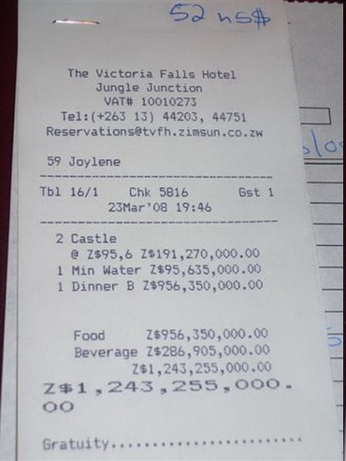
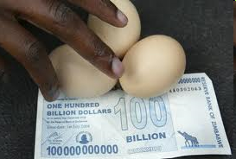
Life in Zimbabwe’s Hyperinflation

Slide 5
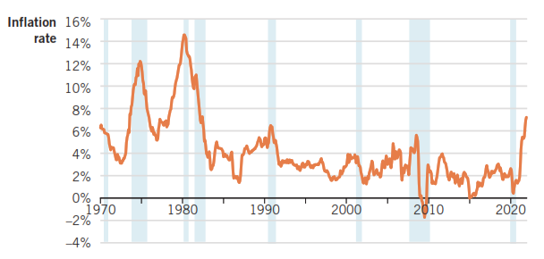
Inflation in the United States: 1970–2021
Inflation rate over the last year: FRED

Slide 6
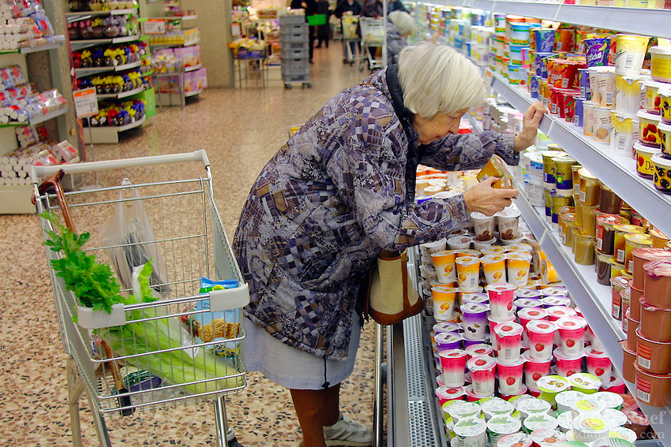

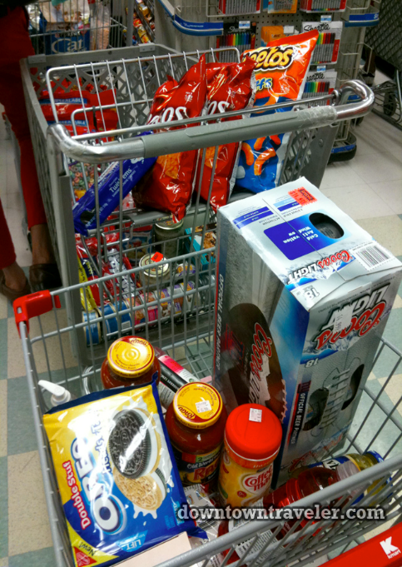
Consumer Price Index (What’s in Your basket?)
Consumer Price Index (CPI)
A measure of the price level based on the consumption patterns of a consumer
Typical “basket” of goods and services

Slide 7
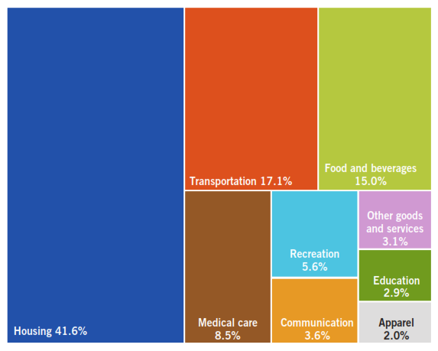
The CPI Market Basket, December 2021

Slide 8
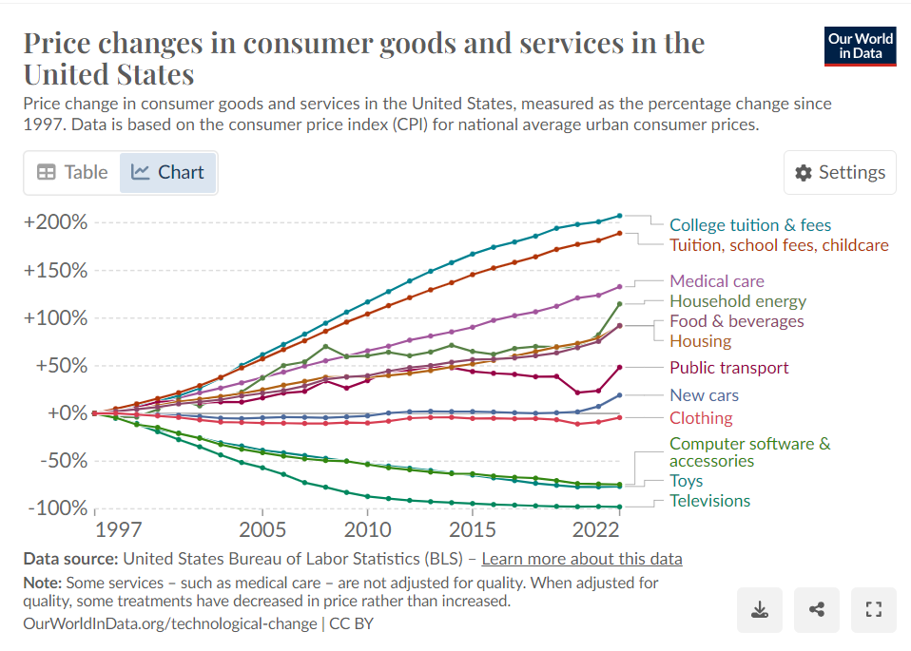
Price Changes in Consumer Goods & Services in the USA, 1997-2022

Slide 9
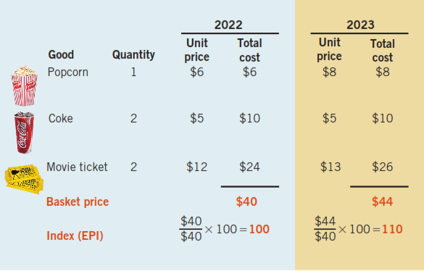
Constructing the CPI

Slide 10
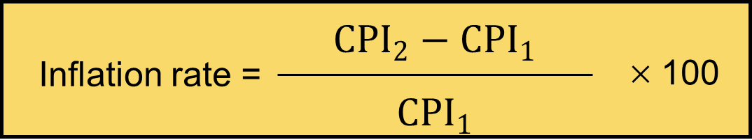
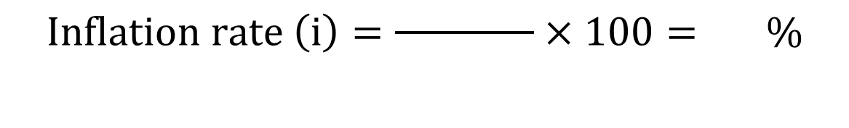
Inflation
Measure the inflation rate (i) as the percentage change in the price level (P).
In the previous example…
$$\text{I}\text{nflation} \text{rate} \left(i\right)=\frac{ }{ }×\text{100}= \%$$

Slide 11
Classroom Example
Suppose there is a small nation of people who idolize the tv program Farmer Wants a Wife.
All they consume are guitars & cowboy hats, in the following amounts.
Using 2022 as the base year, calculate the: (i) price index & (ii) inflation rate for 2023.
 | Market Basket Quantity | 2022 Price | 2023 Price
Guitars | 1 | $150 | $200
Cowboy hats | 3 | $20 | $25

Slide 12
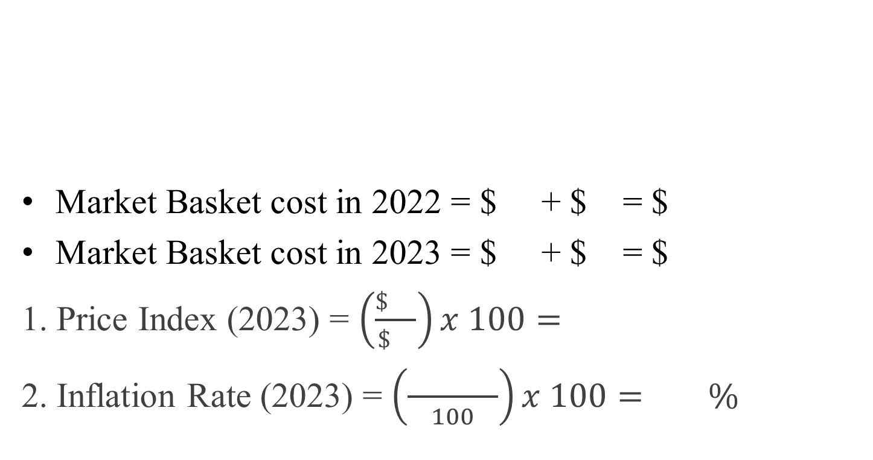
Classroom Example
 | Market Basket Quantity | 2022 Price | 2023 Price
Guitars | 1 | $150 | $200
Cowboy hats | 3 | $20 | $25
Market Basket cost in 2022 = $ + $ = $
Market Basket cost in 2023 = $ + $ = $
1. Price Index (2023) = $\left(\frac{\$ }{\$ }\right)x 100=$
2. Inflation Rate (2023) = $\left(\frac{ }{100}\right)x 100= \%$

Slide 13
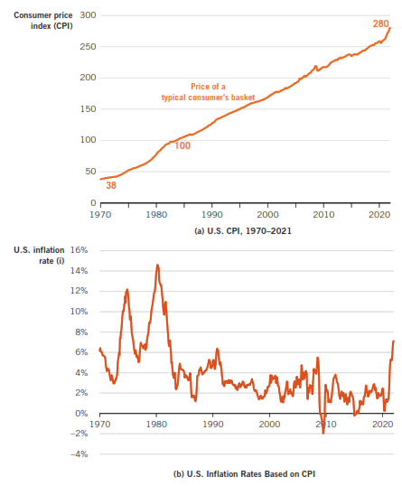
CPI and Inflation in the Long Run (1970-2021)

Slide 14
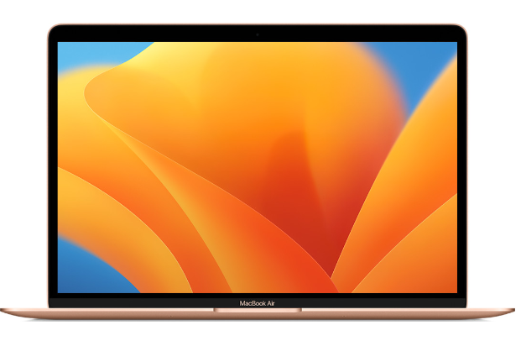
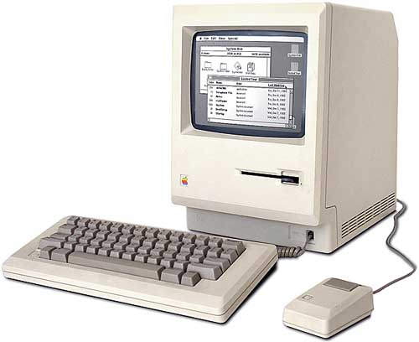
Prices Don’t All Move Together
The overall price level generally rises, but some individual items might stay the same or even decrease.
1984 Macintosh Price: $
2023 Apple MacBook Air Price: $

Slide 15
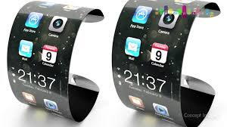
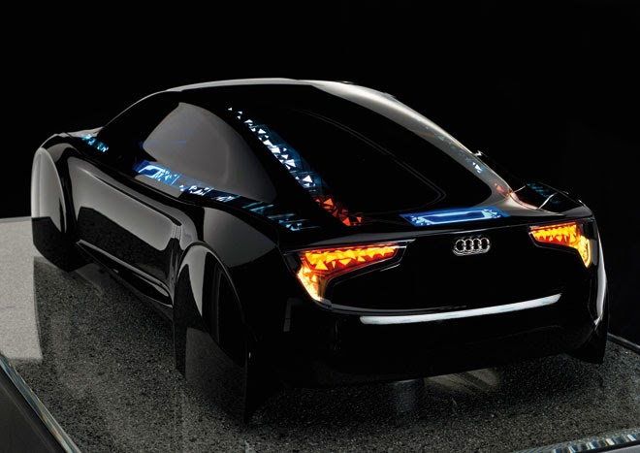
How Accurate is the CPI?
Not realistic that we buy the same things year after year.
Concern that CPI overstates true inflation:
1. Substitution bias
2. Changes in quality
3. New products & locations

Slide 16
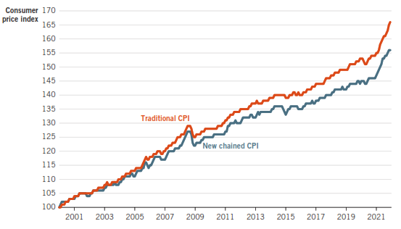
Traditional versus Chained CPI
Chained CPI reduces upward bias of CPI by updating the consumer’s basket of goods & services every month.

Slide 17
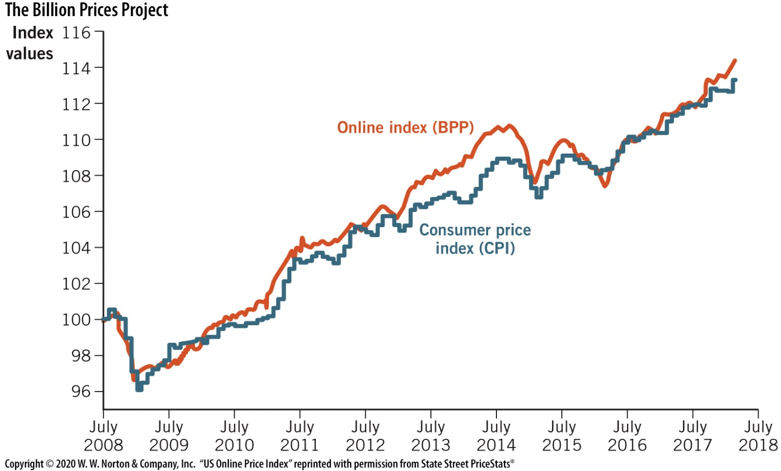
The Billion Prices Project
(BPP) tracks price changes of about 5 million items sold online
Data is similar to CPI

Slide 18
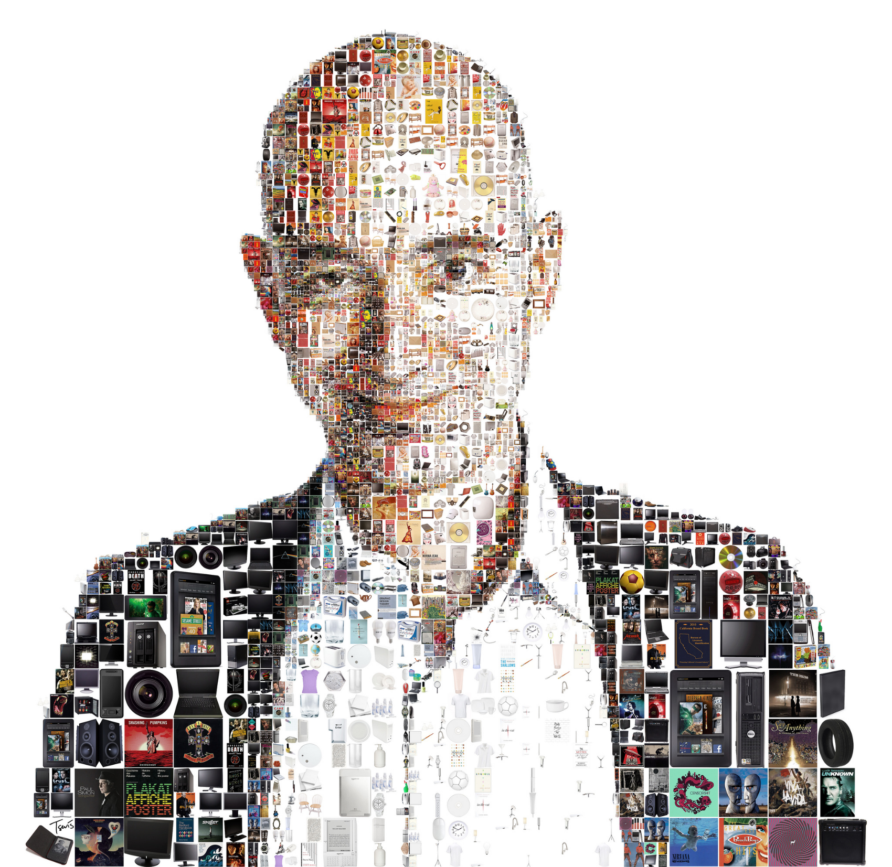
Jeff Bezos
A price index is like this mosaic photo of Amazon’s CEO. An index cannot capture all of the important drivers.

Slide 19
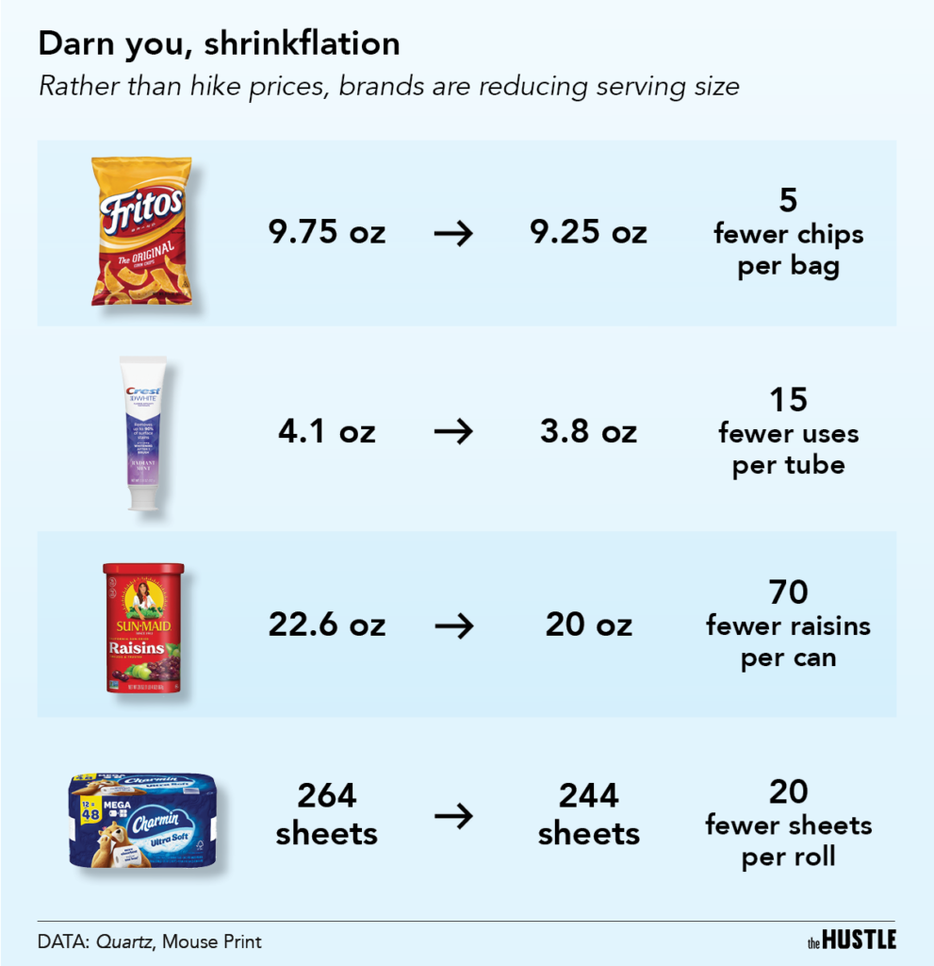

Slide 20
Costs of Inflation
1. Shoe-leather costs
2. Money illusion
3. Menu costs
4. Future price level uncertainty
5. Wealth redistribution
6. Price confusion
7. Tax distortion

Slide 21
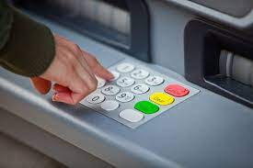
1. Shoe-Leather Costs
Refer to the resources that are wasted when people change their behavior to avoid holding money.

Slide 22

2. Money Illusion
When people interpret nominal changes as real changes
Nominal wage:
The wage expressed in current dollars.
Real wage:
The wage adjusted for changes in the price level.
Real

Slide 23
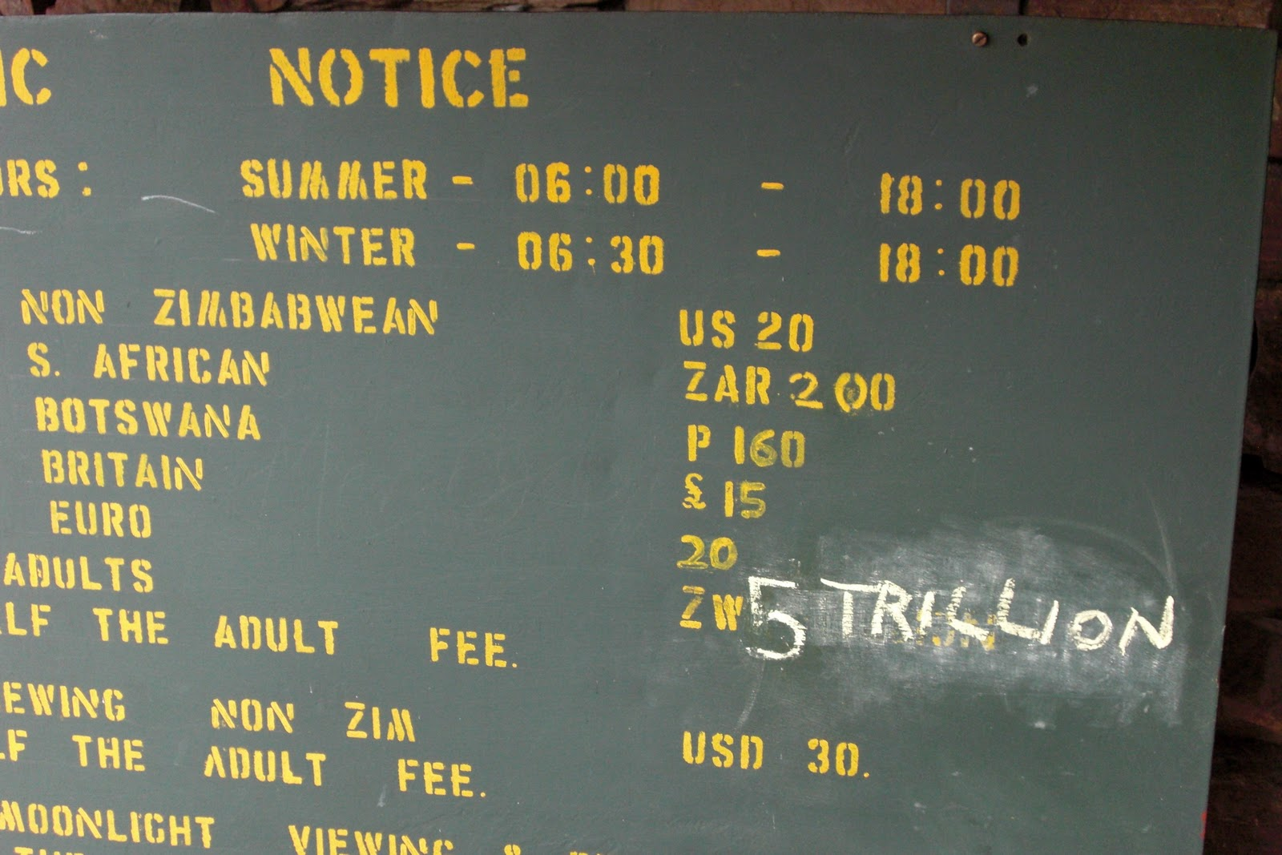
3. Menu Costs
The costs of changing prices

Slide 24
4. Future Price Level Uncertainty
Affects spending on resources
Can slow future output and economic growth
The real value of these future dollars depends on inflation.
Prepare to Produce
Produce
Sell Output
Borrow $$
Build Capital Goods
Hire Workers
Repay Loans $$
Pay Workers $$
Today
Future Periods
Time

Slide 25
5. Wealth Distribution
Inflation can redistribute wealth between borrowers & lenders.
Example: Suppose you borrow $50,000 at 20%.
How much do you expect to pay back in 5 years? $60,000
1. If unexpected inflation occurs, you win.
2. If the inflation was expected the bank would have adjusted the nominal rate.
3. If unexpected deflation occurs, the bank wins.

Slide 26

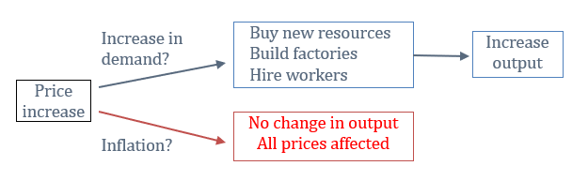
6. Price Confusion
Price act as a signal for producers.
When it is difficult to determine whether prices are changing from demand shifts rather than inflation

Slide 27
7. Tax Distortions
Capital gains taxes are taxes on the gains realized by selling an asset for more than its purchase price.
Problem: often, the price rises due to inflation rather than an increase in the value of the good.
Example: If you buy a house in 1990 for $ 130000 & sell the house in 2020 for $ 260000:
Capital gains = $130,000
You have to pay taxes on this $130,000
However, if CPI rose from 130 to 260 in those years, the real value of the house is the same!

Slide 28
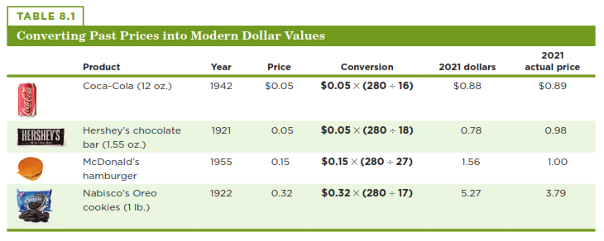
Using the CPI to Compare Dollar Values Across Time
To compare prices over time, we convert past prices to today’s prices.

Slide 29
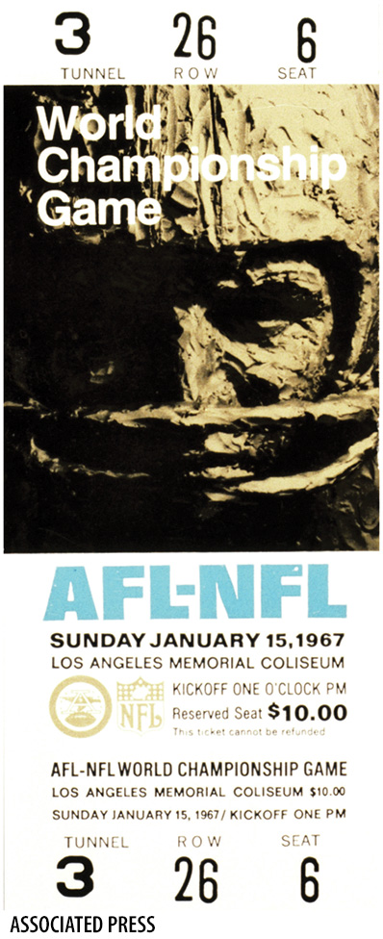
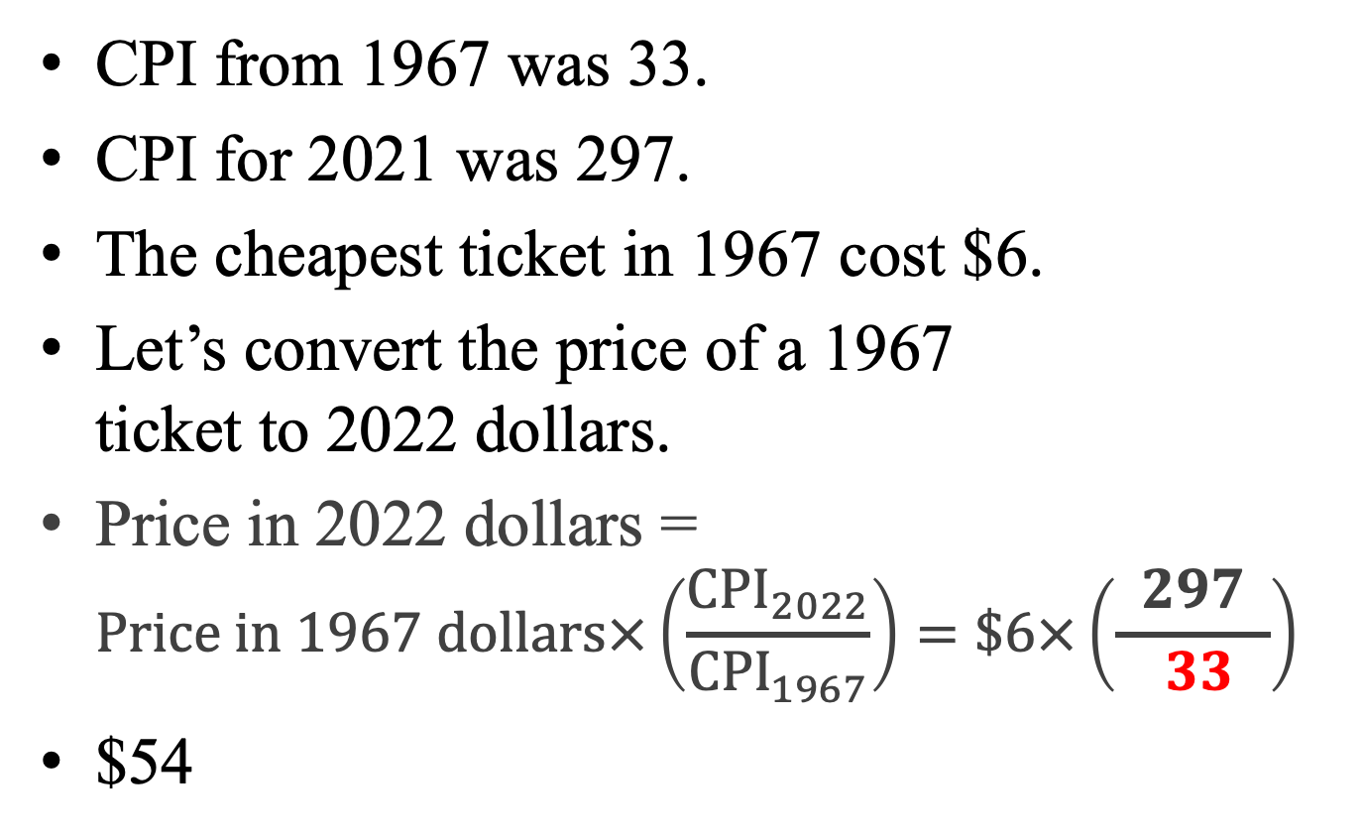
How Cheap were the first Super Bowl Tickets?
CPI from 1967 was 33.
CPI for 2021 was 297.
The cheapest ticket in 1967 cost $6.
Let’s convert the price of a 1967 ticket to 2022 dollars.
Price in 2022 dollars = $Price in 1967 dollars×\left(\frac{{CPI}_{2022}}{{CPI}_{1967}}\right)=\$6×\left(\frac{ 297 }{ 33 }\right)=\$$
$54

Slide 30
What is the top grossing film of all time?
Real
Nominal

Slide 31
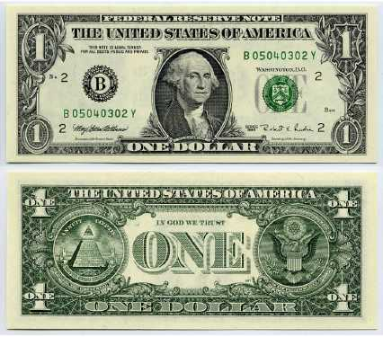
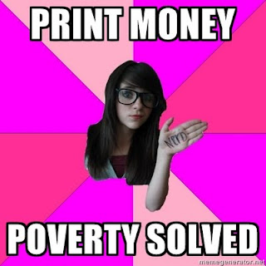
The Main Cause of Inflation
Inflation is consistently traced to expansion in a nation’s money supply
Inflation and money growth move together
When the supply of money in an economy grows relative to the quantity of goods and services, then it takes more money to buy any particular good or service.
Money becomes less valuable – and this is inflation.

Slide 32
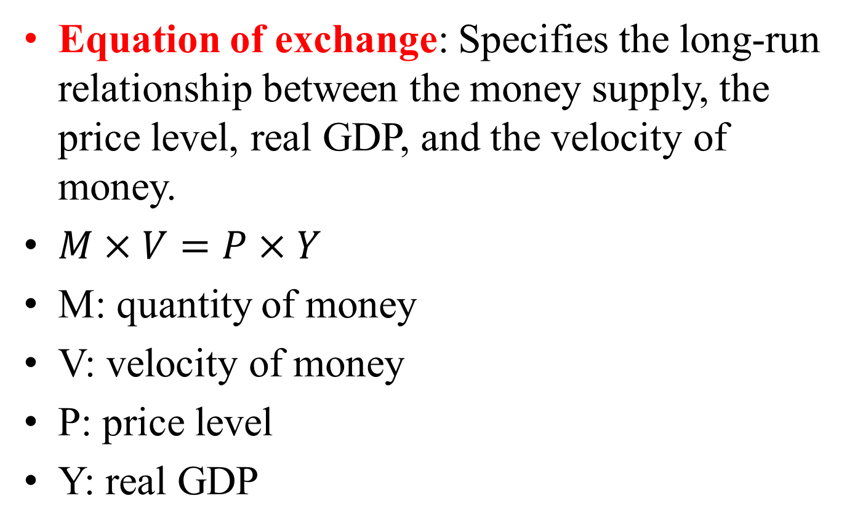
Equation of Exchange
Equation of exchange: Specifies the long-run relationship between the money supply, the price level, real GDP, and the velocity of money.
$M×V=P×Y$
M: quantity of money
V: velocity of money
P: price level
Y: real GDP

Slide 33
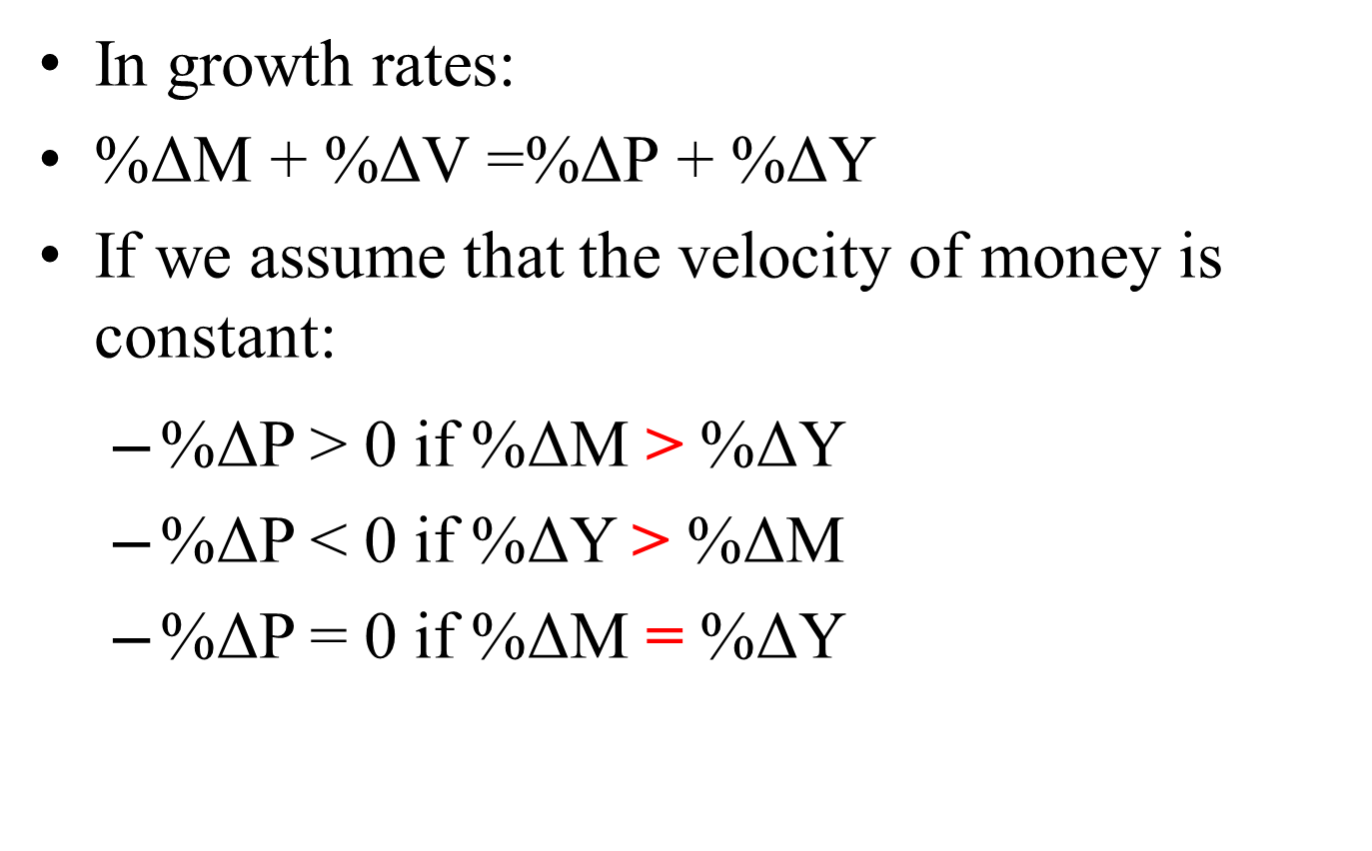
Equation of Exchange
In growth rates:
$\text{\%}\text{Δ}\text{M}\text{ + \%}\text{Δ}\text{V}\text{ =\%}\text{Δ}\text{P}\text{ + \%}\text{Δ}\text{Y}$
If we assume that the velocity of money is constant:
%ΔP > 0 if %ΔM > %ΔY
%ΔP < 0 if %ΔY > %ΔM
%ΔP = 0 if %ΔM = %ΔY

Slide 34
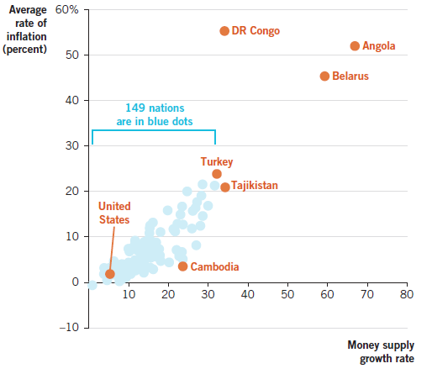
Inflation and Money Growth Rates, 1996-2016

Slide 35

Other Causes of Inflation
1. Cost-push inflation
Arises as a result of a (negative) supply shock.
Occurs when there is a rise in the costs of production, e.g. rise in wages or a natural disaster.
2. Demand-pull inflation
Caused by an increase in the aggregate demand for goods & services.

Slide 36
Cost Push Inflation (supply side)
P
S1
E1
P1
D
Q
Q1

Slide 37
Demand Pull Inflation (demand side)
P
S
E1
P1
D
Q
Q1

